Slide 1
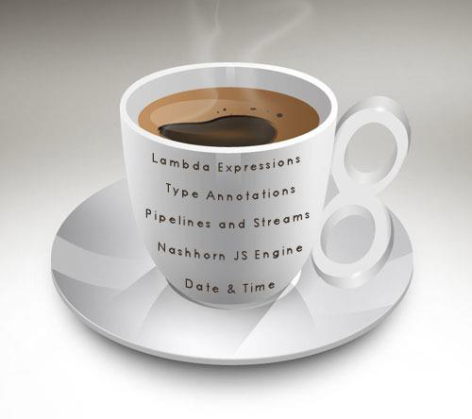
Day 3
Java 8
By
Shalini Mittal

Slide 2

Changes in existing APIs
Date Time API
Repeating Annotations
Annotation types
Parameter Names
Type Inference
Parallel Arrays

Slide 3
Java 1.0 Problems With Date API…..
System.currentTimeMillis()
java.util.Date class returned a human view with following flaws :
Constructors that accept year arguments require offsets from 1900, which has been a source of bugs.
January is represented by 0 instead of 1, also a source of bugs.
Date doesn't describe a date but describes a date-time combination.
Date's mutability makes it unsafe to use in multithreaded scenarios without external synchronization.
Date isn't amenable to internationalization.

Slide 4
Next What? Java 1.1
java.util.Calendar and related classes that riddled with following flaws
January is represented by 0 instead of 1
Calendar isn't type-safe; for example, you must pass an int-based constant to the get(int field) method. (enums weren't available when Calendar was released.)
Calendar's mutability makes it unsafe to use in multithreaded scenarios
Calendar stores its state internally in two different ways -- as a millisecond offset from the epoch and as a set of fields -- resulting in many bugs and performance issues.
java.sql's Date, Time, and Timestamp classes extend java.util.Date and inherit its problems.
Also, in order to prevent setting the time part in the Date class and the date part in the Time class, Date and Time force various setter methods to throw IllegalArgumentException, which is messy.

Slide 5
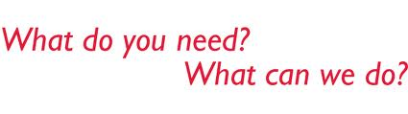

Java 8 DateTime API

Slide 6
Java 8 Date Time API To The Rescue…..
Immutability
Separation of Concerns
Clarity
Utility operations
Extendable
All the classes use Factory Pattern and Strategy Pattern for better handling.
Notes:
Separation of concerns: The new API separates clearly between human readable date time and machine time (unix timestamp). It defines separate classes for Date, Time, DateTime, Timestamp, Timezone etc.
Clarity: The methods are clearly defined and perform the same action in all the classes. For example, to get the current instance we have now() method. There are format() and parse() methods defined in all these classes rather than having a separate class for them.
Utility operations: All the new Date Time API classes comes with methods to perform common tasks, such as plus, minus, format, parsing, getting separate part in date/time etc.
Extendable: The new Date Time API works on ISO-8601 calendar system but we can use it with other non ISO calendars as well.

Slide 7
Java 8 Date Time API packages
java.time Package
Base package
LocalDate, LocalTime, LocalDateTime, Instant, Period, Duration etc.
All of these classes are immutable and thread safe.
java.time.chrono Package:
This package defines generic APIs for non ISO calendar systems.
We can extend AbstractChronology class to create our own calendar system.
java.time.format Package
Classes used for formatting and parsing date time objects.
Most of the times, we would not be directly using them because principle classes in java.time package provide formatting and parsing methods.
java.time.temporal Package:
Use it for find out specific date or time related to date/time object. For example, we can use these to find out the first or last day of the month. You can identify these methods easily because they always have format “withXXX”.
java.time.zone Package
This package contains classes for supporting different time zones and their rules.

Slide 8
Repeating Annotations
Apply the same annotation to a declaration or type use
Repeat an annotation anywhere that you would use a standard annotation
Declare Repeatable annotation type
Mark with @Repeatable annotaion
@Repeatable(TestCases.class)
@Retention( RetentionPolicy.RUNTIME )
public @interface TestCase {
int param();
boolean expected();}
The value of the @Repeatable meta-annotation, in parentheses, is the type of the container annotation that the Java compiler generates to store repeating annotations

Slide 9
Repeating Annotations - Contd
Declare Containing annotation type
The containing annotation type must have a value element with an array type.
The component type of the array type must be the repeatable annotation type
public @interface TestCases
{
TestCase[] value();
}
To retrieve annotations , Reflection API can be used

Slide 10
Type Annotations
Annotations that can be placed anywhere you use a type.
Includes the new operator, type casts, implements clauses and throws clauses.
Allow improved analysis of Java code and can ensure even stronger type checking.
Examples:
Class instance creation expression:
new @Interned MyObject();
Type cast:
myString = (@NonNull String) str;
implements clause:
class UnmodifiableList<T> implements @Readonly List<@Readonly T> { ... }
Thrown exception declaration:
void monitorTemperature() throws @Critical TemperatureException { ... }

Slide 11
ElementTypes added
ElementType.TYPE_USE
Can be applied at any type use
ElementType.TYPE_PARAMETER
Allows an annotation to be applied at type variables (e.g. MyClass<T>)

Slide 12
Parameter Names
Way to preserve method parameter names in Java byte-code and make them available at runtime
Feature available into the language using:
Reflection API Parameter.getName() method)
the byte-code (using new javac compiler argument –parameters)

Slide 13
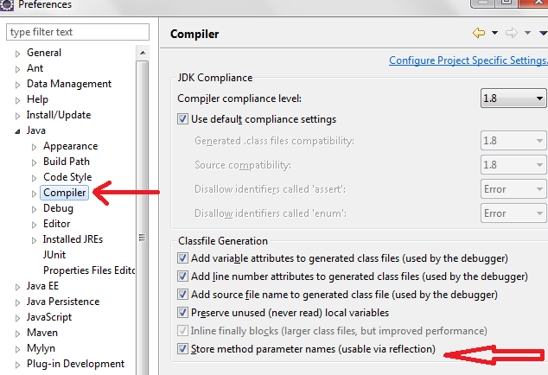
Setting javac command –parameters in eclipse

Slide 14
Type Inference
The explicit type parameters could be inferred by compiler keeping the code cleaner
Example :
public class MyGenericClass<T> {
public static <T> T defaultValue() {
return null; }
public T getOrDefault( T value, T defaultValue ) {
return ( value != null ) ? value : defaultValue;
} }
//JAVA 8
final MyGenericClass<String> value = new MyGenericClass<>();
System.out.println(value.getOrDefault( "22", MyGenericClass.defaultValue() ));
//PRIOR TO JAVA 8
System.out.println(value.getOrDefault( “22",MyGenericClass.<String>defaultValue() ));

Slide 15
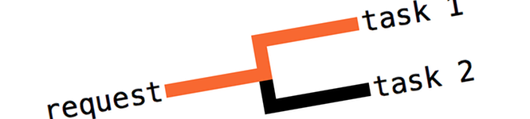
Parallel Arrays
To allow parallel arrays processing.
The most important one is parallelSort() which may significantly speed up the sorting on multicore machines
Added in java.util.Arrays

Slide 16

Any Question ?

Slide 17

Thank you !

